Slide 1
Phase vocoder, part 1
What you’ll learn:
Segmenting a real-time signal into windows
Working with overlapping windows (overlap-add)
Multi-threaded audio processing
What you’ll make:
A phase vocoder framework with simple effects

Slide 2
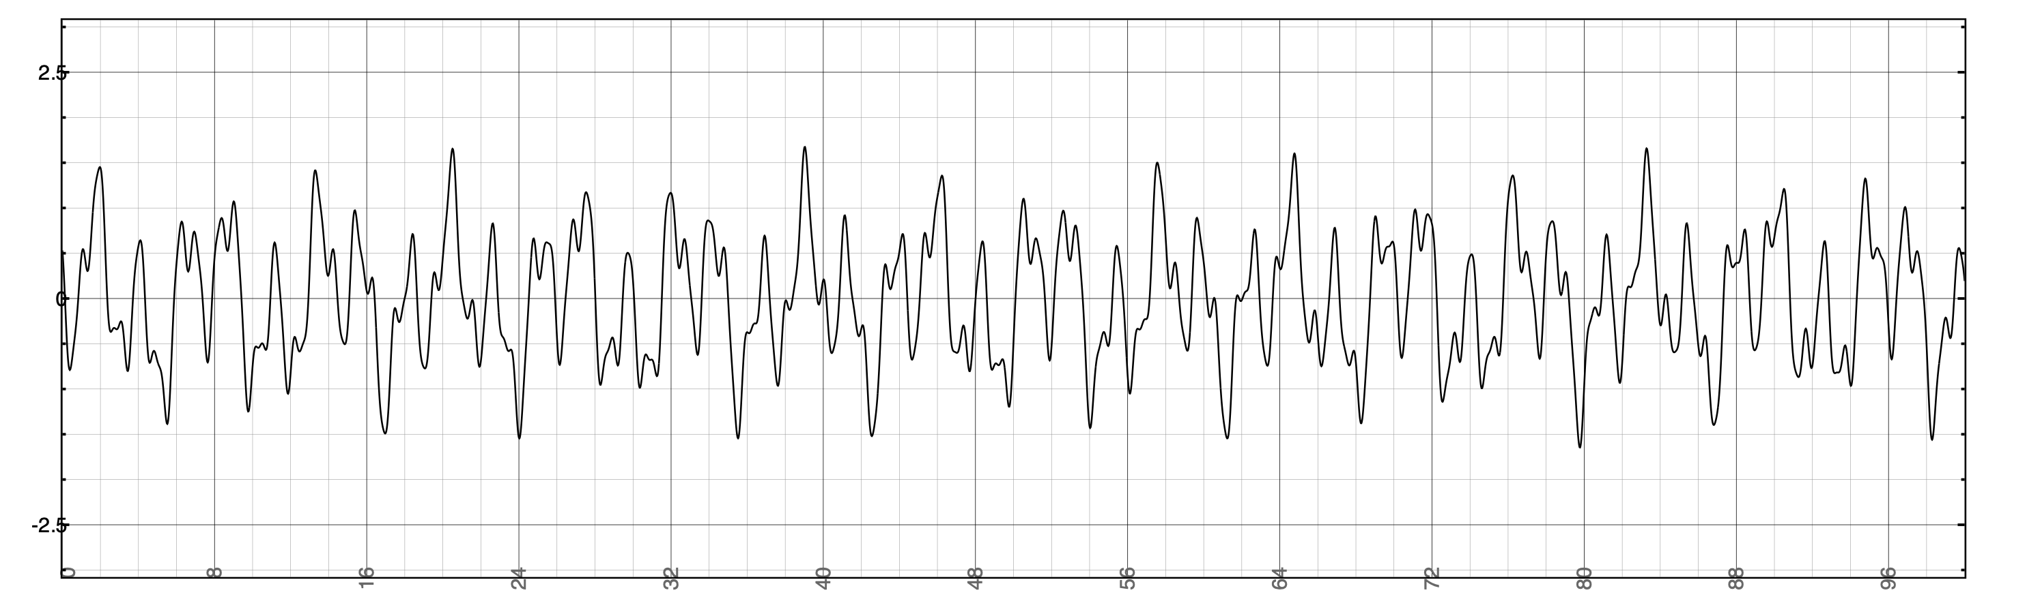
Block-based processing
Sometimes audio calculations need to run on block of samples
For example: wait until 512 samples arrive, then do something with all of them at once
Compare this to filters, where we calculate new output every sample
With block-based processing, we typically run calculation periodically, not every sample
run calculation

Slide 3
Block-based input
Block 0
Block 1
Block 2
x[n]
S0
S1
S2
S3
S4
S5
S6
S7
S8
S9
S10
S11
S12
S13
S14
S15
S16
S17
S18
S19
S20
S21
S22
S23
...
current
sample
write
pointer
Apply
window
Apply
window
Apply
window
Block-based
processing
Block-based
processing
input
buffer
Block-based
processing
S12
S6
S13
S7
S14
S8
S15
S9
S10
S16
S11
S0
S1
S2
S3
S4
S17
S5
Start with a buffer of fixed size
Fill it up sample by sample
When it’s full, apply the window function and pass it to the FFT (or other block based process)

Slide 4
Block-based input and output
After we divide signal into windows, often want to reconstruct it
Do some processing on each block
Stitch processed blocks together into
new signal
If we don’t process each block,
should reconstruct signal exactly
Application: phase vocoder
FFT on each block
Do processing in frequency domain
Use phase of bins for accurate frequency
estimate (more soon!)
IFFT on each block

Slide 5
Block-based input and output
Ideal block-based processing system might work something like this:
Block 0
Block 1
Block 2
x[n]
S0
S1
S2
S3
S4
S5
S6
S7
S8
S9
S10
S11
S12
S13
S14
S15
S16
S17
S18
S19
S20
S21
S22
S23
...
current
sample
Problem: not causal!
write
pointer
Apply
window
Block-based
processing
Apply
window
Apply
window
Block-based
processing
input
buffer
Block-based
processing
output
buffer
S12
S13
S14
S15
S16
S17
Y12
Y6
Y13
Y7
Y14
Y8
Y15
Y9
Y10
Y16
Y11
S0
Y17
S6
S1
S7
S2
S8
S3
S9
S10
S4
S11
S5
Y0
Y1
Y2
Y3
Y4
Y5
read
pointer
y[n]
Y0
Y1
Y2
Y3
Y4
Y5
Y6
Y7
Y8
Y9
Y10
Y11
Y12
Y13
Y14
Y15
Y16
Y17
...

Slide 6
Block-based output: causality
For causal system, output cannot depend on future inputs
Partial solution: add 1-window latency to output
As we gather input samples for next FFT, copy samples from last FFT into output
Block 0
Block 1
Block 2
x[n]
S0
S1
S2
S3
S4
S5
S6
S7
S8
S9
S10
S11
S12
S13
S14
S15
S16
S17
S18
S19
S20
S21
S22
S23
...
...
Block-based
processing
Block-based
processing
Block-based
processing
Block-based
processing
y[n]
S0
S1
S2
S3
S4
S5
S6
S7
S8
S9
S10
S11
S12
S13
S14
S15
S16
S17
S18
S19
S20
S21
S22
S23
...
Problem: y[0] depends on x[5]. System is not causal!

Slide 7
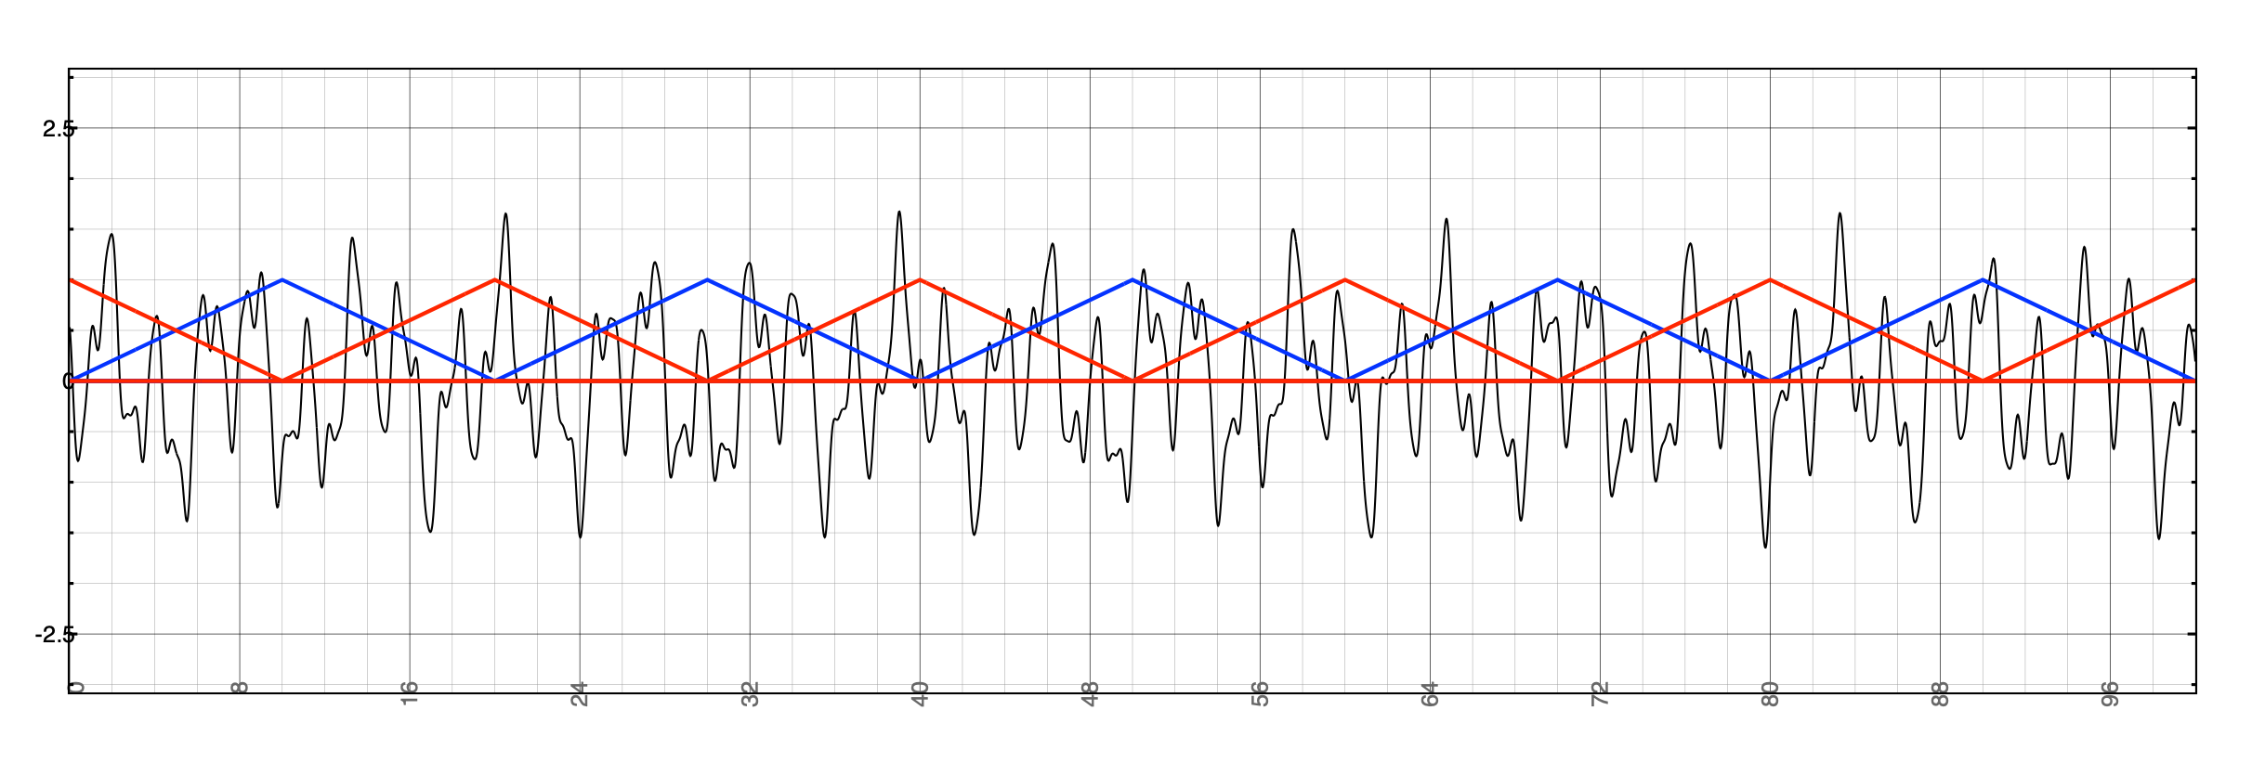
Overlapping blocks
Previous example performed a block calculation at regular intervals
Once a full block of samples was assembled, it was processed (e.g. using an FFT)
Larger the window (block) size, the less frequent the calculations
In that example, each input sample was part of exactly one block
It can be useful to have blocks that overlap one another
For example, use larger FFTs but calculate them more often
Number samples between the start of consecutive blocks is called the hop size
This is often fraction of block size (or window size)
For example, FFT size 1024, hop size 512
We might apply a window function before calculating the FFT
In this example, a triangular window
Window size = M
Hop size = M/2

Slide 8
Overlap-Add
Standard approach for block-based processing with overlapping blocks is called overlap-add:
Isolate block of length M using windowing function
Take FFT of length N ≥ M of segment
If N > M, zero-pad block (add zeros to end of window)
Do something interesting to frequency-domain data
Take IFFT to get new time domain segment
Add the segment to an output buffer which also contains the preceding segments
As we’ll see, can’t write segment directly to audio output
Advance by hop size (H) to next frame and repeat
In real time, count samples until H more have arrived
Hop size H is less than window size M, hence the overlap
FFT
effect
IFFT

Slide 9
Review: overlapping blocks (input side)
Block 0
Block 1
Block 2
x[n]
S0
S1
S2
S3
S4
S5
S6
S7
S8
S9
S10
S11
S12
S13
S14
S15
S16
S17
S18
S19
S20
S21
S22
S23
...
S0
S1
S4
S5
S6
S7
S8
S9
S12
S13
S14
S15
S16
S17
S20
S21
S22
S2
S23
S3
S10
S11
S18
S19
y[n]
...
Goal is to work with overlapping blocks in real time
This means block k shares some samples with block k-1
How do we adapt our windowing code to handle this?
Easiest approach: keep a running history of the input samples
i.e. a buffer which always has the last M samples
What kind of structure have seen that does this?
At each hop, pass M samples from circular buffer to FFT
Circular buffer

Slide 10
Review: overlap-add with a circular buffer
We use a circular buffer to keep track of the input
Necessary characteristics:
The buffer always holds (at least) the last M input samples (where M is the window size)
If using multiple channels, one buffer per channel
Using the circular buffer:
Each iteration of the for() loop:
store input in buffer
increment the write pointer (wrapping as necessary)
increment the total count of samples stored
When the count reaches the hop size:
take one window from buffer, unwrap it, and pass it to FFT
in other words: copy it to a new buffer such that the oldest sample appears at index 0 of the new buffer
latest
window
(M = 8 in this
example)
x[23]
x[24]
x[25]
x[22]
x[26]
x[21]
x[3]
Important: this
is not the same as
when the write
pointer wraps around!
x[20]
x[4]
x[19]
x[5]
write pointer
x[18]
(next sample to
be replaced)
x[6]
x[17]
x[7]
x[16]
x[8]
x[15]
x[9]
x[14]
x[10]
x[13]
x[12]
x[11]

Slide 11
Review: unwrapping the circular buffer
How the circular buffer is actually stored in memory:
latest
window
(M = 8 in this
example)
x[24]
x[25]
x[26]
x[3]
x[4]
x[5]
x[6]
x[7]
x[8]
x[9]
x[10]
x[11]
x[12]
x[13]
x[14]
x[15]
x[16]
x[17]
x[18]
x[19]
x[20]
x[21]
x[22]
x[23]
x[23]
x[24]
x[25]
x[22]
x[26]
x[21]
x[3]
What we need to calculate the FFT (the latest 8 samples):
x[20]
x[4]
x[19]
x[5]
x[19]
x[20]
x[21]
x[22]
x[23]
x[24]
x[25]
x[26]
write pointer
x[18]
(next sample to
be replaced)
x[6]
x[17]
x[7]
In other words: having assembled the samples into a circular buffer, on each hop it is helpful to copy them into a linear (standard) buffer to pass to the FFT library
x[16]
x[8]
x[15]
x[9]
x[14]
x[10]
x[13]
x[12]
x[11]

Slide 12
Block-based output: overlap
Block 0
Block 1
Block 2
x[n]
S0
S1
S2
S3
S4
S5
S6
S7
S8
S9
S10
S11
S12
S13
S14
S15
S16
S17
S18
S19
S20
S21
S22
S23
...
Note: these output
samples are
the sum of parts
of two different
blocks
Block-based
processing
Block-based
processing
Block-based
processing
Block-based
processing
Block-based
processing
output
buffer
We need an intermediate output buffer (different from the system audio output) to hold the results of our block-based calculation
Each window, the new output should be added into that buffer
A sample can be sent from there to the system output as soon as all the blocks it depends on have been calculated (this implies a latency of at least 1 window)

Slide 13
Output circular buffer
Output
circular buffer:
Circular buffer to get output from overlap-add
Different from input circular buffer
Keep track of 2 pointers in circular output buffer
Write pointer: where does next block get written once it’s calculated?
moves in jumps of hop size
Read pointer: where to get next sample for system output?
moves continuously frame by frame
Write pointer must remain ahead of read pointer
Necessary characteristics of the output buffer:
Hold at least W+H samples, where W is window size, H hop size
One buffer per channel of signal
Needs array, write pointer from FFT & read pointer to system output
Using the output buffer:
After inverse FFT, add result into output buffer, starting at write pointer
In processBlock, copy from output buffer to audio output at read pointer
Then set sample you just copied to 0
Finally, increment read pointer
xxx
xxx
xxx
xxx
xxx
xxx
xxx
xxx
xxx
xxx
xxx
read
pointer
xxx
xxx
xxx
xxx
xxx
xxx
xxx
xxx
xxx
xxx
write
pointer
xxx
xxx
xxx

Slide 14
The full signal chain
Block 0
Block 1
Block 2
x[n]
S0
S1
S2
S3
S4
S5
S6
S7
S8
S9
S10
S11
S12
S13
S14
S15
S16
S17
S18
S19
S20
S21
S22
S23
...
write
pointer
this happens once per hop (every H samples)
most
recent W
samples
add
result
input
buffer
Apply
window
Block-based
processing
output
buffer
at write
pointer
these processes
happen every frame
read pointer
S0
S1
S4
S5
S6
S7
S8
S9
S12
S13
S14
S15
S16
S17
S20
S21
S22
S2
S23
S3
S10
S11
S18
S19
y[n]
...
ECS7012P Music and Audio Programming • Week 10a

Slide 15
Overlap-add task
Task: using fft-overlap-add project, implement the output circular buffer
Variables are already declared for you at the top of the file
Write pointer is for keeping track of where the next block is written
Read pointer keeps track of where to copy samples to the audio output
Notice that process_fft() takes four arguments:
input buffer, input pointer, output buffer, output write pointer
Look at bottom of process_fft() to see how output is copied to the buffer
Add your code in render():
Copy samples from the output buffer to the audio output (use the variable out)
After you copy the output, set that sample in the output buffer to 0
Increment the output circular buffer pointers in the relevant places
Which one happens every frame? Which one advances once per hop?
Once it works, try uncommenting the robotise code in process_fft()
ECS7012P Music and Audio Programming • Week 10a

Slide 16
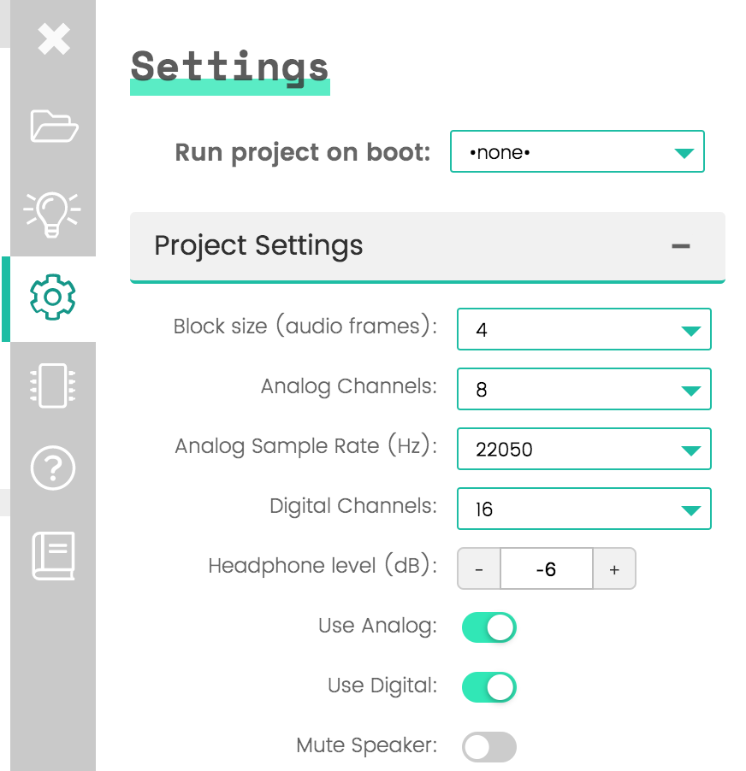
Block-based processing performance
Try changing the block size to 4 samples
What happens to the output? Why?

Slide 17
The full signal chain: performance
Block 0
Block 1
Block 2
x[n]
S0
S1
S2
S3
S4
S5
S6
S7
S8
S9
S10
S11
S12
S13
S14
S15
S16
S17
S18
S19
S20
S21
S22
S23
...
write
pointer
How long do the FFT and IFFT have to run?
most
recent W
samples
1 sample. Why might this be a problem?
add
result
input
buffer
Apply
window
Block-based
processing
output
buffer
at write
pointer
read pointer
S0
S1
S4
S5
S6
S7
S8
S9
S12
S13
S14
S15
S16
S17
S20
S21
S22
S2
S23
S3
S10
S11
S18
S19
y[n]
...
ECS7012P Music and Audio Programming • Week 10a

Slide 18
Intermittent CPU load
We've been assuming the CPU load is roughly constant over time
Even if the average load is within limits, the instantaneous load might not be!
Example: say we do an FFT every 10 samples
Let's assume only the FFT takes any time
With a buffer size of 8, we're fine:
Calculation takes less than one buffer length
But with a buffer size of 4, we're not...
Calculation takes longer than a call to render()
S0
S1
S4
S5
S6
S7
S8
S9
S12
S13
S14
S15
S16
S17
S20
S21
S22
S2
S23
S3
S10
S11
S18
S19
FFT
FFT
S0
S1
S2
S3
S4
S5
S6
S7
S8
S9
S10
S11
S12
S13
S14
S15
S16
S17
S18
S19
S20
S21
S22
S23
...
FFT
FFT
ECS7012P Music and Audio Programming • Week 10a

Slide 19
Handling intermittent load
S0
S1
S2
S3
S4
S5
S6
S7
S8
S9
S10
S11
S12
S13
S14
S15
S16
S17
S18
S19
S20
S21
S22
S23
FFT
FFT
What can we do about occasional, heavy load?
Most calls to render() do almost nothing; some calls can't finish on time...
We should add latency so the result doesn’t need to be ready in 1 sample
But that still doesn’t solve the problem if a calculation spans multiple calls to render()
Solution: move the expensive process to another thread
Run the FFT on a thread with lower priority than render()
The FFT thread will use whatever processing is left over when render() is not running
ECS7012P Music and Audio Programming • Week 10a

Slide 20
The full signal chain: added latency
Block 0
Block 1
Block 2
x[n]
S0
S1
S2
S3
S4
S5
S6
S7
S8
S9
S10
S11
S12
S13
S14
S15
S16
S17
S18
S19
S20
S21
S22
S23
...
write
pointer
Now we have 1 full hop to finish
the FFT calculations
most
recent W
samples
add
result
input
buffer
Apply
window
Block-based
processing
output
buffer
at write
pointer
read pointer
S0
S1
S4
S5
S6
S7
S8
S9
S12
S13
S14
S15
S16
S17
S20
S21
S22
S2
S23
S3
S10
S11
S18
S19
y[n]
...
ECS7012P Music and Audio Programming • Week 10a

Slide 21
Multi-threaded processing
use two threads
render(): high priority, runs every callback, finishes quickly
process_fft(): lower priority, runs occasionally, takes longer to finish
This will run whenever render() is not running
Still higher priority than the rest of Linux
With 2 threads, render() always runs first
The rest of the time is spent on the FFT, which could span multiple callbacks
FFT thread should sleep and wait for a signal to run
render() should send the signal when a new hop has elapsed
render() also needs to tell FFT thread where to find data (locations of buffers & pointers it needs)
FFT thread should run calculation, store the output in the buffer, then return
S0
S1
S2
S3
S4
S5
S6
S7
S8
S9
S10
S11
S12
S13
S14
S15
S16
S17
S18
S19
S20
S21
S22
S23
render()
process_fft()
FFT

Slide 22
Multi-threaded processing
With 2 threads, render() always runs first
The rest of the time is spent on the FFT, which could span multiple callbacks
process_fft() is allowed to be interrupted by render()
That means we need to be careful not to let render() modify any variables process_fft() was using
Main concern here is the input buffer pointer, which will keep changing before process_fft() is even allowed to run. Need to cache this value (save a copy that render() won’t change).
Reverse isn’t true: render() won’t be interrupted because it has higher priority
S0
S1
S2
S3
S4
S5
S6
S7
S8
S9
S10
S11
S12
S13
S14
S15
S16
S17
S18
S19
S20
S21
S22
S23
render()
process_fft()
FFT

Slide 23
Threading task
S0
S1
S2
S3
S4
S5
S6
S7
S8
S9
S10
S11
S12
S13
S14
S15
S16
S17
S18
S19
S20
S21
S22
S23
render()
process_fft()
FFT
Task: using the fft-overlap-add-threads project
Convert the code to run the FFT in a second thread
Use JUCE
Also finish implementing process_fft_background()

